Slide 3
Session 1: God is Love
The life of God the Holy Trinity is an eternal communion of love. All who are baptized in the name of the Trinity and profess the apostolic faith share in this communion. Because it is rooted in baptism, we can call it ‘baptismal communion’.
The Church gives visible expression to this communion. ‘Ecclesial communion’ (the communion of the Church) involves confession of the one faith, celebration of one Eucharist and leadership by an apostolic ministry.
Because the communion of the Holy Trinity is a communion of love, the communion of the Church must be marked by charity (love).
Communion and Catholicity in the Church of England, section 1 – summary

Slide 4
Michael Bublé (b. 1975) is a Canadian singer, many of whose songs express the popular idea of love.
From To Be Loved
But you'll be truly
Truly truly love
But there's more
one of these things
You want
Someone to kiss
Someone to miss
When you're away
To hear from each day
To be loved
To be loved
Oooh
Whatta feelin
To be loved
Oooh
https://www.youtube.com/watch?v=2I-WGGTILBk

Slide 5
About a saint of the Church
Maximilian Kolbe (1894-1941) was a Franciscan, who died in a stranger’s place at Auschwitz.
In order to discourage escapes, Auschwitz had a rule that if a man escaped, ten men would be killed in retaliation. In July 1941 a man from Kolbe's bunker escaped. The dreadful irony of the story is that the escaped prisoner was later found drowned in a camp latrine, so the terrible reprisals had been exercised without cause. But the remaining men of the bunker were led out.
'The fugitive has not been found!' the commandant Karl Fritsch screamed. 'You will all pay for this. Ten of you will be locked in the starvation bunker without food or water until they die.' The prisoners trembled in terror. A few days in this bunker without food and water, and a man's intestines dried up and his brain turned to fire.
The ten were selected, including Franciszek Gajowniczek, 2 imprisoned for helping the Polish Resistance. He couldn't help a cry of anguish. 'My poor wife!' he sobbed. 'My poor children! What will they do?' When he uttered this cry of dismay, Maximilian stepped silently forward, took off his cap, and stood before the commandant and said, 'I am a Catholic priest. Let me take his place. I am old. He has a wife and children.'
Astounded, the icy-faced Nazi commandant asked, 'What does this Polish pig want?'
Father Kolbe pointed with his hand to the condemned Franciszek Gajowniczek and repeated 'I am a Catholic priest from Poland; I would like to take his place, because he has a wife and children.'
Observers believed in horror that the commandant would be angered and would refuse the request, or would order the death of both men. The commandant remained silent for a moment. What his thoughts were on being confronted by this brave priest we have no idea. Amazingly, however, he acceded to the request. Apparantly the Nazis had more use for a young worker than for an old one, and was happy to make the exchange.
Franciszek Gajowniczek was returned to the ranks, and the priest took his place ..

Slide 6
Discussion:
What do these two texts have to say about Love?
What does the martyrdom of Maximilian Kolbe teach us about the Christian understanding of Love?
How do we see this Love manifested in the life of Christ and his Saints?

Slide 7
God’s Love: The Trinity and Christ (1)
Love is not what God is like; love is what God is. The love that He is is this pure self-giving love. The doctrine of the Trinity shows us how.
God the Father loves the Son. Because the Father loves the Son, the Father gives the Son everything he has.
What the Father has is what He is (God), so, because the Father loves the Son, he gives the Son his life, his divinity. The Son is equally God because the Father gives him everything the Father is.
God the Son in turn gives himself totally to the Father. They love each other, which is to say that they give themselves wholly to each other.
Since the love the Father and Son give one other is themselves, that love is equal to them, that love is the Spirit.

Slide 8
God’s Love: The Trinity and Christ (2)
Human beings are created in the image of this God of self-giving love. Because He holds nothing back from us, He gives us a share in His freedom, which involves the freedom to reject Him. This we have done. Instead of being self-giving, sin has made us selfish. In the Fall, human beings used the freedom that God gave them not to give themselves totally to Him in return, but for their own sake.
In creation God gives us everything He has as God. In the Incarnation, God gives us everything He has as a man. Christ lives the life of God as a man. In His human life we see the love that God the Son gives to the Father in the world.
Christ offers the Father everything He has, as He does as God the Son. This offering is made for us all on the Cross.
Our task as part of Christ’s Body, the Church, is given to us by Jesus in His great summary of the Law: ‘Love the Lord your God, with all your heart, with all your might, and with all your strength, and love your neighbour as yourself.’

Slide 9
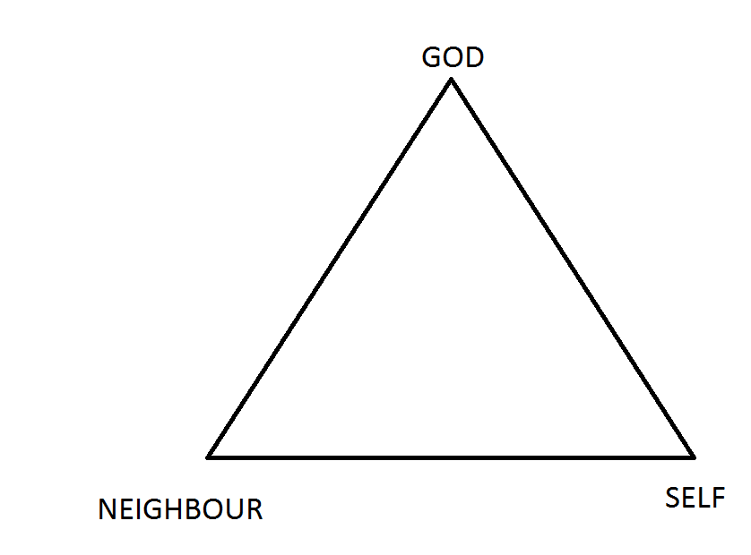
God’s Love: The Trinity and Christ (3)

Slide 10
Human Love: Charity
The English words ‘love’ and ‘charity’ both come from the same Latin word, caritas. So the real meaning of charity is love.
Charity is the foundation of the Christian life. For the world, charity means giving money away; for Christians it means giving everything away. We are to give our lives to God, and to others for Him. St Paul writes that ‘faith, hope, charity abide, these three. But the greatest of these is charity.’
If we love God, we give ourselves totally to Him. This is only right. Since God made us, we are His, and He has a right to us. Because God created other men, women, and children in his image, we must love them for His sake. The crucified Jesus is the foundation of all this. He gave His life to the Father for the sake of His fellow human beings.
Our lives should look like the cross. They should go in two directions: the main direction of our lives (the main beam of wood) should be our offering to God, but we should also offer ourselves to our fellow men and women (the cross-beam).

Slide 11
Questions
Can I give more of myself to God? Can I make time to pray every day? Can I get to Mass more frequently than I do? Do I go to confession?
Who is my neighbour? How would God want me to love my neighbour, and how should I respond to that?
Can I give more of myself to others? Are there acts of charity that I could be doing, but aren’t? Are there people whom I could help in my local area?

Slide 12
Concluding Prayer
O LORD, who hast taught us that all our doings without charity are nothing worth: Send thy Holy Ghost, and pour into our hearts that most excellent gift of charity, the very bond of peace and of all virtues, without which whosoever liveth is counted dead before thee. Grant this for thine only Son Jesus Christ's sake. Amen.

